Slide 1
Automation Training
Day 3

Slide 2
SELENIUM Automation
- Autobots

Slide 3

SELENIUM
Developed by: Jason Huggins
Developed in: 2004
Developed at: Thoughtworks
Language: Selenese
Currently owned by: Google (2009)

Slide 4

Why Selenium ?
QTP (QuickTest Professional) WHICH WAS THEN OWNED BY “Mercury interactive corporation” WAS LEADING THE AUTOMATION INDUSTRY BEFORE SELENIUM WAS INTRODUCED.
One day Jason Huggins fired a joke on ‘Mercury’ as part of an email conversation "Mercury poisoning can be cured by taking Selenium Supplements" This joke has resulted in naming the product as Selenium.

Slide 5
Selenium webdriver workflow Automates web based applications by below simple steps
Identifies objects on the UI using unique locators.
Performs requested actions using the identified objects.
Asserts the actions performed or will through an error.

Slide 6
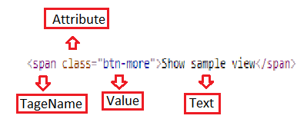
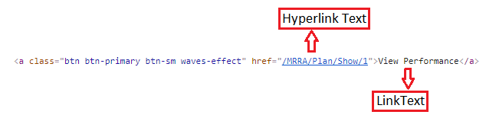
UI DOM Introduction

Slide 7
Locators:
ClassName
ID
LinkText
Name
PartialLinkText
Tag Name
CssSelector
Xpath

Slide 8
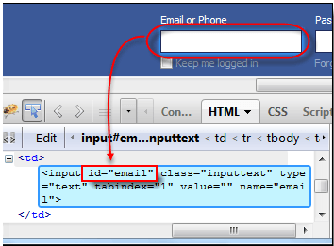
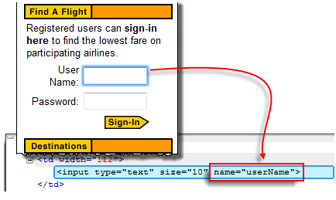
Locators vs Tagnames
Locating by ID
Locating by Name

Slide 9
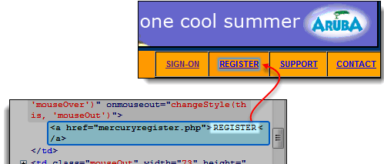
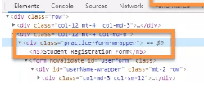
Locators vs Tagnames
Locating by Class Name
Locating by Link Text

Slide 10

Locators vs Tagnames
Locating by partial Link Text
Locating by Tag Name

Slide 11
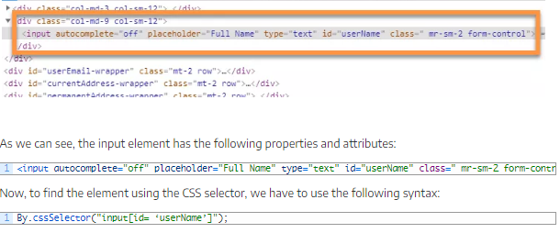
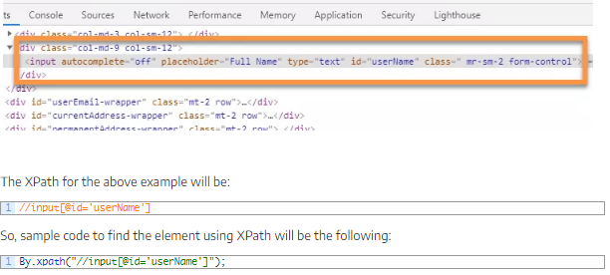
Locators vs Tagnames
Locating by css selector
Locating by xpath

Slide 12
Syntax:
css selector
tagname[@attribute=‘value’]
Xpath
//tagname[@attribute=‘value’]
//tagname[text()=‘value’]
//tagname[contains(text(),‘value’)]
//tagname[contains(@attribute,‘value’)]

Slide 13


Slide 14
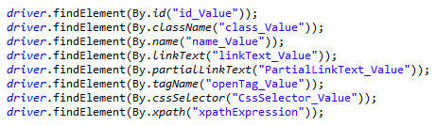
Object Identification in Selenese

Slide 15
Performing actions:
click()
sendKeys()
getText()
doubleClick()
clickAndHold()
dragAndDrop()

Slide 16

Let’s code

Slide 17

Questions

Slide 18


